Slide 1

Python Case Study 3 Clustering
overall_0_132225817714872234 columns_1_132225817714872234

Slide 2

Agenda
overall_0_132335268282037724 columns_1_132225817802942803 2_1_132335268182249538
Step 1: Import Libraries
Step 2: Import Dataset
Step 3: Exploratory Data Analysis
Step 4: Univariate Data Analysis
Step 5: Bi-variate Analysis
Step 6: Data Preparation
Step 7: Modelling
Step 8: Evaluate Performance

Slide 3
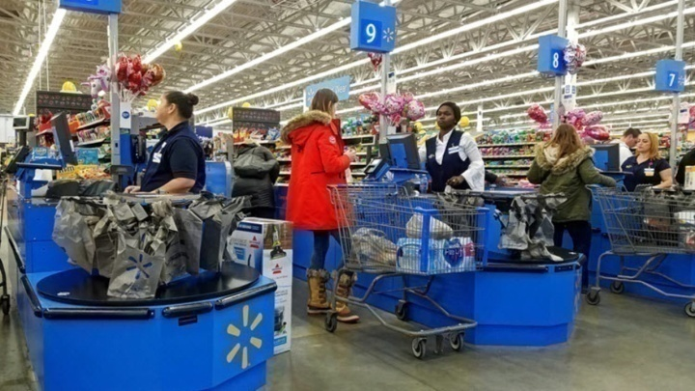
Problem Statement
overall_0_132335268282037724 columns_1_132225817802942803 2_1_132335268182249538
You are working as a data scientist in the Walmart. Walmart has asked you to develop a model for one of the retail store in Boulder. If they like your work, they will ask you to replicate the model for other Walmart retail stores as well
You would like to develop a model to get sense of customers and classify them into different cohorts/groups
You are given the following attributes for 2000 customers (based on the Loyalty card they use at checkout)
Customer ID
Sex/Gender
Martial Status
Education
Income
Occupation (Unskilled/Skilled/Highly skilled)
Settlement Size (The size of the city that the customer lives in)
The model should be able to classify customers into different cohorts so that suitable marketing strategies can be used for individual cohort
Note: Dataset is codified and a separate Data dictionary is provided herein for your reference

Slide 4
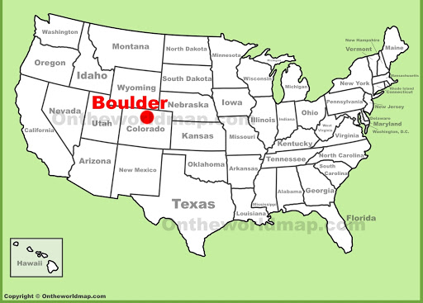
Problem Statement
overall_0_132335268282037724 columns_1_132225817802942803 2_1_132335268182249538
About Boulder:
Boulder is a small town located in Colorado. Many high school and university students come to Boulder for attaining education
After attaining education, students get placed in top-notch software companies in Boulder.
However, due to limited jobs in Boulder, some students look for job opportunity in their home-town cities or nearby big cities such as Louisville, Westminster, etc. These big cities are a few miles away from Boulder

Slide 5
Agenda
overall_0_132335268282037724 columns_1_132225817802942803 2_1_132335268182249538
Step 1: Import Libraries
Step 2: Import Dataset
Step 3: Exploratory Data Analysis
Step 4: Univariate Data Analysis
Step 5: Bi-variate Analysis
Step 6: Data Preparation
Step 7: Modelling
Step 8: Evaluate Performance

Slide 6

Step 1: Import Libraries
overall_0_132335268282037724 columns_1_132225817802942803 2_1_132335268182249538
Import Libraries
Pandas (Used for Table/Data Frame Manipulations)
Numpy (Used for Numerical Analysis)
Matlplotlib.pyplot (Used for Basic Visualization)
Seaborn (Used for Advanced Visualization)
Code:
import pandas as pd
import numpy as np
import matplotlib.pyplot as plt
import seaborn as sns

Slide 7
Agenda
overall_0_132335268282037724 columns_1_132225817802942803 2_1_132335268182249538
Step 1: Import Libraries
Step 2: Import Dataset
Step 3: Exploratory Data Analysis
Step 4: Univariate Data Analysis
Step 5: Bi-variate Analysis
Step 6: Data Preparation
Step 7: Modelling
Step 8: Evaluate Performance

Slide 8

Step 2: Import Dataset
overall_0_132335268282037724 columns_1_132225817802942803 2_1_132335268182249538
Import Dataset (without encoding)
>> dataset = pd.read_csv('/content/segmentation data.csv')

Slide 9
Agenda
overall_0_132335268282037724 columns_1_132225817802942803 2_1_132335268182249538
Step 1: Import Libraries
Step 2: Import Dataset
Step 3: Exploratory Data Analysis
Step 4: Univariate Data Analysis
Step 5: Bi-variate Analysis
Step 6: Data Preparation
Step 7: Modelling
Step 8: Evaluate Performance

Slide 10

Step 3: Exploratory Data Analysis
overall_0_132335268282037724 columns_1_132225817802942803 2_1_132335268182249538
Overall
Exploratory Data Analysis
Performing initial investigations on data with the help of summary statistics
It involves
To understand the data
to discover patterns (through any initial hypothesis)
to spot anomalies (missing data, outlier, etc)

Slide 11
Step 3: Exploratory Data Analysis
overall_0_132335268282037724 columns_1_132225817802942803 2_1_132335268182249538
UNDERSTAND DATA
Check the number of rows and columns in the dataset (shape)
Know column and their corresponding data type (info)
Check top 5 rows in the dataset (head)
Check last 5 rows in the dataset (tail)
Describing statistical summary of dataset (describe)
Check NULL values in the dataset

Slide 12
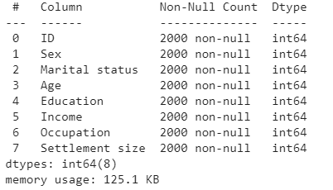
Step 3: Exploratory Data Analysis
overall_0_132335268282037724 columns_1_132225817802942803 2_1_132335268182249538
UNDERSTAND DATA
Check the number of rows and columns in the dataset
>> dataset.shape
(2000, 8)
The data has 2000 customers and 8 columns.
Out of these 8 columns, 0 column is dependent variable and all 8 are independent variables
Know column and their corresponding data type
>> dataset.info()
There is no null value in any column
The datatype for all the columns are int

Slide 13
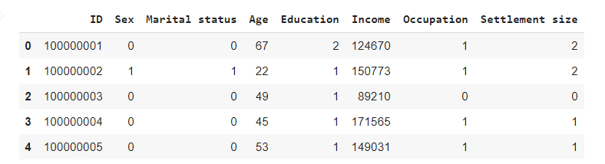
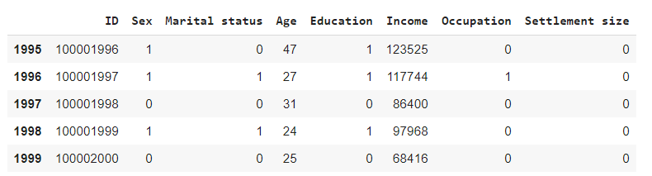
Step 3: Exploratory Data Analysis
overall_0_132335268282037724 columns_1_132225817802942803 2_1_132335268182249538
UNDERSTAND DATA
Check the top 5 rows in the dataset
>> dataset.head()
Check the last 5 rows in the dataset
>> dataset.tail()

Slide 14
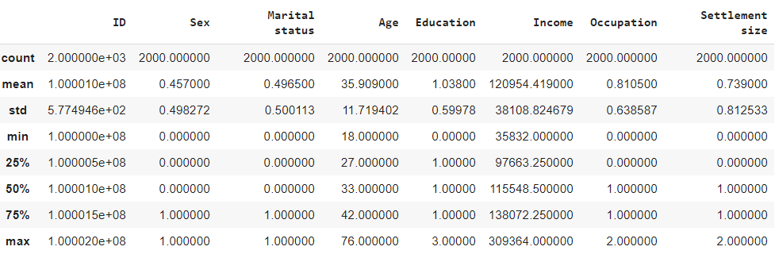
Step 3: Exploratory Data Analysis
overall_0_132335268282037724 columns_1_132225817802942803 2_1_132335268182249538
UNDERSTAND DATA
Describing the statistical summary of the dataset
>> dataset.describe()
Count: We can see that there are 2000 observation in the dataset (No null value in the dataset)
Mean (For continuous variable): The average age is ~36 years and Average Income is ~120k$
Mean (For Categorical variable containing 0 and 1): Shows proportion of 1s in the dataset
Sex: Proportion of female in the dataset is ~45% (and thus, males are ~55%)
Marital Status: ~50% customers are single and remaining 50% customers are non married

Slide 15
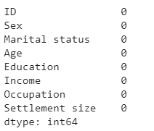
Step 3: Exploratory Data Analysis
overall_0_132335268282037724 columns_1_132225817802942803 2_1_132335268182249538
UNDERSTAND DATA
Check NULL values in the dataset
>> dataset.isnull().sum()
There is no NULL value in the dataset

Slide 16
Agenda
overall_0_132335268282037724 columns_1_132225817802942803 2_1_132335268182249538
Step 1: Import Libraries
Step 2: Import Dataset
Step 3: Exploratory Data Analysis
Step 4: Univariate Data Analysis
Step 5: Bi-variate Analysis
Step 6: Data Preparation
Step 7: Modelling
Step 8: Evaluate Performance

Slide 17

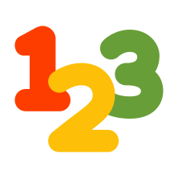
Step 4: Univariate Data Analysis
overall_0_132335268282037724 columns_1_132225817802942803 2_1_132335268182249538
Definition:
“Uni” means “one”, so analyzing one column at a time.
It doesn’t deal with causes or relationships with other columns
For Categorical Variables (e.g. Sex, Marital Status, etc.): Frequency table or Bar chart
For Continuous Variables (e.g. Age, Income, etc.): Box plot or histogram

Slide 18
Step 4: Univariate Data Analysis
overall_0_132335268282037724 columns_1_132225817802942803 2_1_132335268182249538
BIVARIATE Analysis
IDENTIFY RELEVANT COLUMN
S. No. | Column Name | Type | Analysis
1 | ID | Categorical | Not Relevant
2 | Sex | Categorical | Frequency Table/Bar chart
3 | Marital Status | Categorical | Frequency Table/Bar chart
4 | Education | Categorical | Frequency Table/Bar chart
5 | Occupation | Categorical | Frequency Table/Bar chart
6 | Settlement Size | Categorical | Frequency Table/Bar chart
7 | Age | Continuous | Box plot or histogram
8 | Income | Continuous | Box plot or histogram

Slide 19
Step 4: Univariate Data Analysis
overall_0_132335268282037724 columns_1_132225817802942803 2_1_132335268182249538
BIVARIATE Analysis
IDENTIFY RELEVANT COLUMN
S. No. | Column Name | Type | Analysis
1 | ID | Categorical | Not Relevant
2 | Sex | Categorical | Frequency Table/Bar chart
3 | Marital Status | Categorical | Frequency Table/Bar chart
4 | Education | Categorical | Frequency Table/Bar chart
5 | Occupation | Categorical | Frequency Table/Bar chart
6 | Settlement Size | Categorical | Frequency Table/Bar chart
7 | Age | Continuous | Box plot or histogram
8 | Income | Continuous | Box plot or histogram

Slide 20
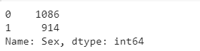
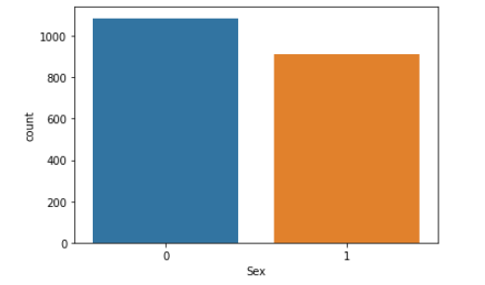
Step 4: Univariate Data Analysis
overall_0_132335268282037724 columns_1_132225817802942803 2_1_132335268182249538
BIVARIATE Analysis
SEX
Frequency Table
Bar Chart
>> dataset['Sex'].value_counts()
>>sns.countplot(dataset[Sex'])
Interpretation:
Males in the dataset are ~1100 (55%)
Females in the dataset are ~900 (~45%)

Slide 21
Step 4: Univariate Data Analysis
overall_0_132335268282037724 columns_1_132225817802942803 2_1_132335268182249538
BIVARIATE Analysis
IDENTIFY RELEVANT COLUMN
S. No. | Column Name | Type | Analysis
1 | ID | Categorical | Not Relevant
2 | Sex | Categorical | Frequency Table/Bar chart
3 | Marital Status | Categorical | Frequency Table/Bar chart
4 | Education | Categorical | Frequency Table/Bar chart
5 | Occupation | Categorical | Frequency Table/Bar chart
6 | Settlement Size | Categorical | Frequency Table/Bar chart
7 | Age | Continuous | Box plot or histogram
8 | Income | Continuous | Box plot or histogram

Slide 22
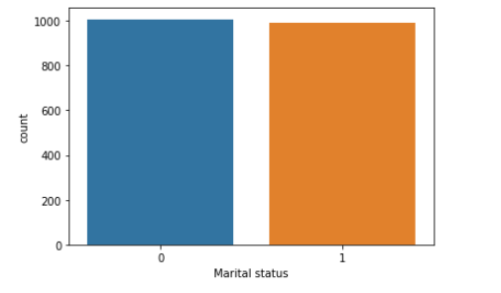
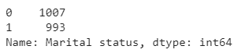
Step 4: Univariate Data Analysis
overall_0_132335268282037724 columns_1_132225817802942803 2_1_132335268182249538
BIVARIATE Analysis
MARITAL STATUS
Frequency Table
Bar Chart
>> dataset['Marital status'].value_counts()
>>sns.countplot(dataset[‘Marital status'])
Interpretation:
There is an almost equal split between married and single customers in the dataset

Slide 23
Step 4: Univariate Data Analysis
overall_0_132335268282037724 columns_1_132225817802942803 2_1_132335268182249538
BIVARIATE Analysis
IDENTIFY RELEVANT COLUMN
S. No. | Column Name | Type | Analysis
1 | ID | Categorical | Not Relevant
2 | Sex | Categorical | Frequency Table/Bar chart
3 | Marital Status | Categorical | Frequency Table/Bar chart
4 | Education | Categorical | Frequency Table/Bar chart
5 | Occupation | Categorical | Frequency Table/Bar chart
6 | Settlement Size | Categorical | Frequency Table/Bar chart
7 | Age | Continuous | Box plot or histogram
8 | Income | Continuous | Box plot or histogram

Slide 24
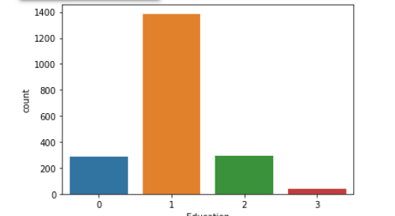
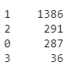
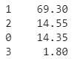
Step 4: Univariate Data Analysis
overall_0_132335268282037724 columns_1_132225817802942803 2_1_132335268182249538
BIVARIATE Analysis
Education
Frequency Table
Bar Chart
>> dataset['Education'].value_counts()
>>sns.countplot(dataset['Education'])
>> dataset['Education'].value_counts()/2000*100
Absolute
Percentage
Interpretation:
High school customers (status =1) in the dataset are ~1400 (70%)
University education (status =2) are 15%
Unknown (status =0) are ~15%
Post graduate customers (status =3) in the dataset are ~1%

Slide 25
Step 4: Univariate Data Analysis
overall_0_132335268282037724 columns_1_132225817802942803 2_1_132335268182249538
BIVARIATE Analysis
IDENTIFY RELEVANT COLUMN
S. No. | Column Name | Type | Analysis
1 | ID | Categorical | Not Relevant
2 | Sex | Categorical | Frequency Table/Bar chart
3 | Marital Status | Categorical | Frequency Table/Bar chart
4 | Education | Categorical | Frequency Table/Bar chart
5 | Occupation | Categorical | Frequency Table/Bar chart
6 | Settlement Size | Categorical | Frequency Table/Bar chart
7 | Age | Continuous | Box plot or histogram
8 | Income | Continuous | Box plot or histogram

Slide 26
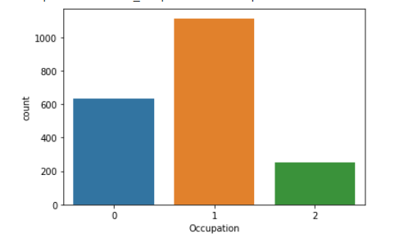
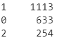
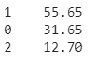
Step 4: Univariate Data Analysis
overall_0_132335268282037724 columns_1_132225817802942803 2_1_132335268182249538
BIVARIATE Analysis
OCCUPATION
Frequency Table
Bar Chart
>> dataset['Occupation'].value_counts()
>>sns.countplot(dataset['Education'])
>> dataset['Occupation'].value_counts()/2000*100
Absolute
Percentage
Interpretation:
Skilled job customers (status =1) in the dataset are ~55%
Unemployed/Unskilled (status =0) are ~30%
High skilled customers (status =2) are ~13%

Slide 27
Step 4: Univariate Data Analysis
overall_0_132335268282037724 columns_1_132225817802942803 2_1_132335268182249538
BIVARIATE Analysis
IDENTIFY RELEVANT COLUMN
S. No. | Column Name | Type | Analysis
1 | ID | Categorical | Not Relevant
2 | Sex | Categorical | Frequency Table/Bar chart
3 | Marital Status | Categorical | Frequency Table/Bar chart
4 | Education | Categorical | Frequency Table/Bar chart
5 | Occupation | Categorical | Frequency Table/Bar chart
6 | Settlement Size | Categorical | Frequency Table/Bar chart
7 | Age | Continuous | Box plot or histogram
8 | Income | Continuous | Box plot or histogram

Slide 28
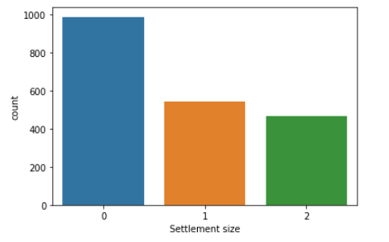
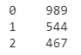
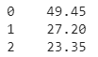
Step 4: Univariate Data Analysis
overall_0_132335268282037724 columns_1_132225817802942803 2_1_132335268182249538
BIVARIATE Analysis
SETTLEMENT SIZE
Frequency Table
Bar Chart
>>sns.countplot(dataset['Settlement size'])
>> dataset['Settlement size'].value_counts()
>> dataset['Settlement size'].value_counts()/2000*100
Absolute
Percentage (%)
Interpretation:
Small city (status = 0 ) in the dataset are ~50%
Mid sized and big city customers (status =1 and 2) are ~25% each

Slide 29
Step 4: Univariate Data Analysis
overall_0_132335268282037724 columns_1_132225817802942803 2_1_132335268182249538
BIVARIATE Analysis
IDENTIFY RELEVANT COLUMN
S. No. | Column Name | Type | Analysis
1 | ID | Categorical | Not Relevant
2 | Sex | Categorical | Frequency Table/Bar chart
3 | Marital Status | Categorical | Frequency Table/Bar chart
4 | Education | Categorical | Frequency Table/Bar chart
5 | Occupation | Categorical | Frequency Table/Bar chart
6 | Settlement Size | Categorical | Frequency Table/Bar chart
7 | Age | Continuous | Box plot or histogram
8 | Income | Continuous | Box plot or histogram

Slide 30
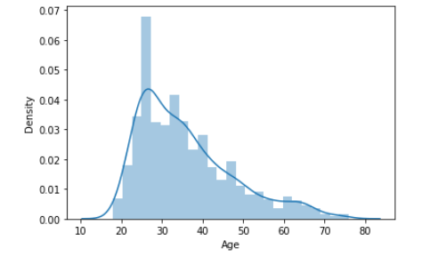
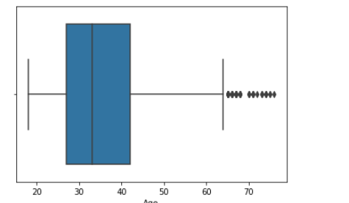
Step 4: Univariate Data Analysis
overall_0_132335268282037724 columns_1_132225817802942803 2_1_132335268182249538
BIVARIATE Analysis
Age
Histogram
Bar Chart
>>sns.distplot(dataset['Age'])
>>sns.boxplot(dataset['Age'])
Most of the customers are between 20 to 40 years of age
There are few outliers on right sides but the outlier seems legitimate as age could be 76 (maximum age in dataset)

Slide 31
Step 4: Univariate Data Analysis
overall_0_132335268282037724 columns_1_132225817802942803 2_1_132335268182249538
BIVARIATE Analysis
IDENTIFY RELEVANT COLUMN
S. No. | Column Name | Type | Analysis
1 | ID | Categorical | Not Relevant
2 | Sex | Categorical | Frequency Table/Bar chart
3 | Marital Status | Categorical | Frequency Table/Bar chart
4 | Education | Categorical | Frequency Table/Bar chart
5 | Occupation | Categorical | Frequency Table/Bar chart
6 | Settlement Size | Categorical | Frequency Table/Bar chart
7 | Age | Continuous | Box plot or histogram
8 | Income | Continuous | Box plot or histogram

Slide 32
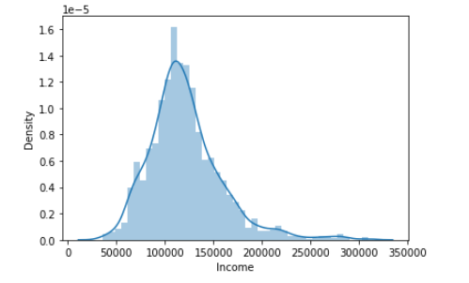
Step 4: Univariate Data Analysis
overall_0_132335268282037724 columns_1_132225817802942803 2_1_132335268182249538
BIVARIATE Analysis
INCOME
Histogram
Bar Chart
>>sns.distplot(dataset[Income'])
>>sns.boxplot(dataset['Age'])
Most of the customers are between 20 to 40 years of age
There are few outliers on right sides but the outlier seems legitimate as age could be 76 (maximum age in dataset)

Slide 33
Step 4: Univariate Data Analysis
overall_0_132335268282037724 columns_1_132225817802942803 2_1_132335268182249538
BIVARIATE Analysis
IDENTIFY RELEVANT COLUMN
S. No. | Column Name | Type | Analysis
1 | ID | Categorical | Not Relevant
2 | Sex | Categorical | Frequency Table/Bar chart
3 | Marital Status | Categorical | Frequency Table/Bar chart
4 | Education | Categorical | Frequency Table/Bar chart
5 | Occupation | Categorical | Frequency Table/Bar chart
6 | Settlement Size | Categorical | Frequency Table/Bar chart
7 | Age | Continuous | Box plot or histogram
8 | Income | Continuous | Box plot or histogram

Slide 34
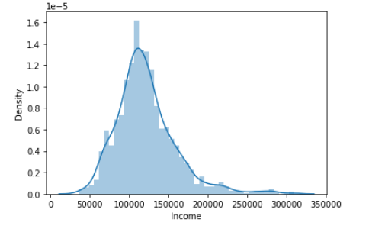
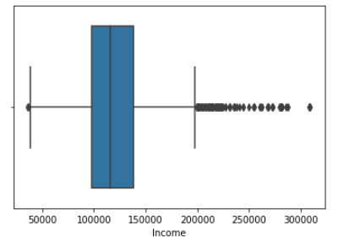
Step 4: Univariate Data Analysis
overall_0_132335268282037724 columns_1_132225817802942803 2_1_132335268182249538
BIVARIATE Analysis
INCOME
Histogram
Bar Chart
>> sns.distplot(dataset[‘Credit Card Debt'])
>>sns.boxplot(dataset['Annual Salary'])
The dataset is largely normally distributed and symmetric
Most of the customers have salary range between$100,000 to $150,000
There are few outliers on both the sides but the outliers seems legitimate

Slide 35
Step 4: Univariate Data Analysis
overall_0_132335268282037724 columns_1_132225817802942803 2_1_132335268182249538
BIVARIATE Analysis
CONCLUSION
1 variable ( Customer ID) is not important for the analysis
Gender: Roughly equal split of Male (55%) and Female (45%) was observed.
Marital status: Roughly equal split between single and married customers was observed
Education: ~85% customers have attained high school and university education; Very few customers are post graduate
Settlement status: ~50% customers are from small city while remaining 50% are from big/medium sized city

Slide 36
Agenda
overall_0_132335268282037724 columns_1_132225817802942803 2_1_132335268182249538
Step 1: Import Libraries
Step 2: Import Dataset
Step 3: Exploratory Data Analysis
Step 4: Univariate Data Analysis
Step 5: Bi-variate Analysis
Step 6: Data Preparation
Step 7: Modelling
Step 8: Evaluate Performance

Slide 37
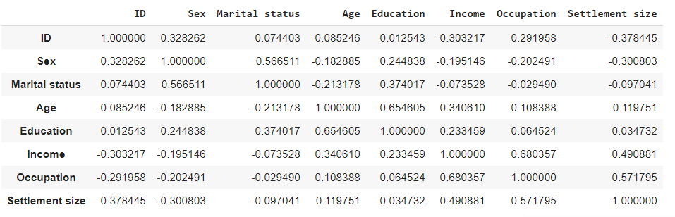
Step 5: Bi-variate Analysis
overall_0_132335268282037724 columns_1_132225817802942803 2_1_132335268182249538
BIVARIATE Analysis
>> dataset.corr()
Create Correlation matrix
As this is an unsupervised algorithm, we don’t have bi-variate analysis in the above correlation matrix
Education has +ve correlation with Age (no correlation with Income, Occupation and Settlement size)
Higher education comes with increasing but that does not necessarily means greater income, occupation
Income has + ve correlation with Occupation

Slide 38
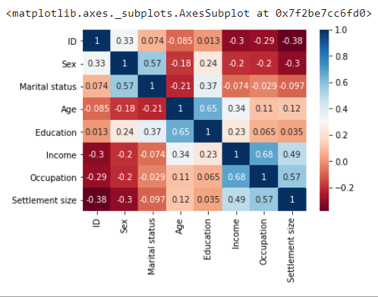
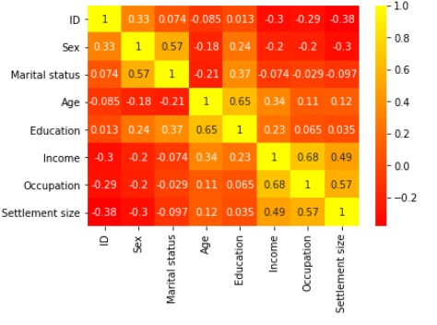
Step 5: Bi-variate Analysis
overall_0_132335268282037724 columns_1_132225817802942803 2_1_132335268182249538
Other cmap options are:
viridis
rainbow
BIVARIATE Analysis
Create Correlation matrix (Beautify)
sns.heatmap(dataset.corr(), cmap='RdBu',annot=True)
cmap = RdBu
cmap = Autumn

Slide 39
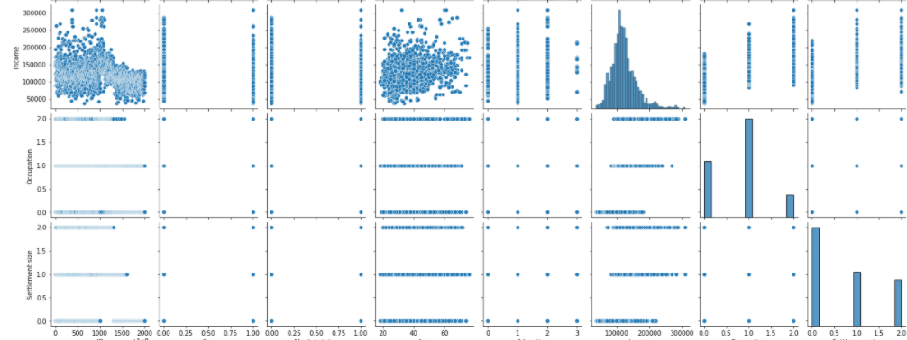
overall_0_132335268282037724 columns_1_132225817802942803 2_1_132335268182249538
Step 5: Bivariate Analysis
BIVARIATE Analysis
Create Pairplot
>> sns.pairplot(dataset)

Slide 40
Agenda
overall_0_132335268282037724 columns_1_132225817802942803 2_1_132335268182249538
Step 1: Import Libraries
Step 2: Import Dataset
Step 3: Exploratory Data Analysis
Step 4: Univariate Data Analysis
Step 5: Bi-variate Analysis
Step 6: Data Preparation
Step 7: Modelling
Step 8: Evaluate Performance

Slide 41

Step 6: Data Preparation
overall_0_132335268282037724 columns_1_132225817802942803 2_1_132335268182249538
BIVARIATE Analysis
Drop non relevant columns
Missing value treatment – Not required
Outlier Treatment – Not required
Standardization

Slide 42
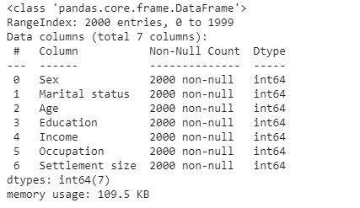
Step 6: Data Preparation
overall_0_132335268282037724 columns_1_132225817802942803 2_1_132335268182249538
BIVARIATE Analysis
Drop non relevant columns
>> dataset.drop(['ID'], axis =1, inplace = True)
>> dataset.info()

Slide 43
Step 6: Data Preparation
overall_0_132335268282037724 columns_1_132225817802942803 2_1_132335268182249538
BIVARIATE Analysis
Standardize Dataset
Standardization (sometimes called data normalization or feature scaling) refers to the process of rescaling the values of the variables in your data set so they share a common scale
Data can have different unit (e.g., inches, meters, tons and kilograms), or
Data scales are very different from one another (e.g., 0-1 vs 0-1000) e.g. Age/Income
This is an important step particularly for cluster analysis as groups are defined based on the distance between points in mathematical space.
>> from sklearn.preprocessing import StandardScaler
>> scaler = StandardScaler()
>> dataset_std = scaler.fit_transform(dataset)

Slide 44
Agenda
overall_0_132335268282037724 columns_1_132225817802942803 2_1_132335268182249538
Step 1: Import Libraries
Step 2: Import Dataset
Step 3: Exploratory Data Analysis
Step 4: Univariate Data Analysis
Step 5: Bi-variate Analysis
Step 6: Data Preparation
Step 7: Modelling
Step 8: Evaluate Performance

Slide 45
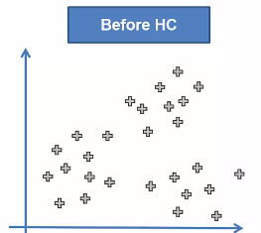
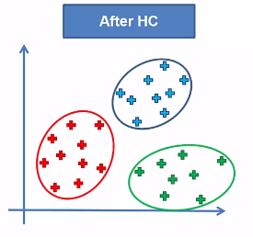
Modeling using Hierarchical Clustering
overall_0_132335268282037724 columns_1_132225817802942803 2_1_132335268182249538
BIVARIATE Analysis

Slide 46
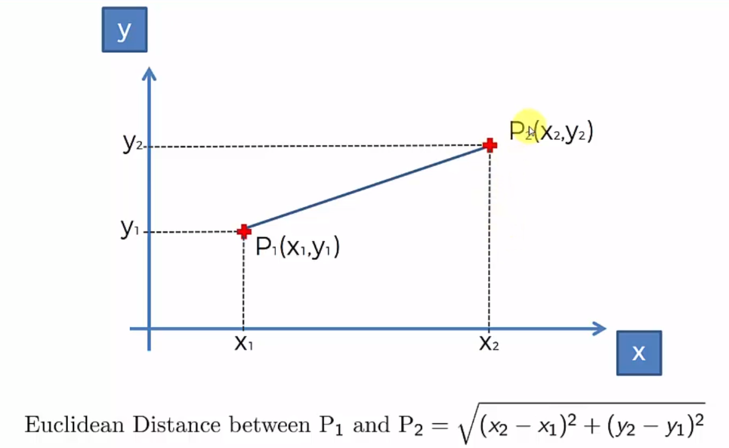
Hierarchical Clustering: Modeling - Euclidean Distance
overall_0_132335268282037724 columns_1_132225817802942803 2_1_132335268182249538
BIVARIATE Analysis

Slide 47
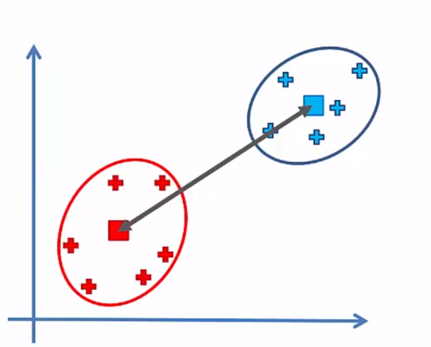
Hierarchical Clustering : Modeling – Distance between two clusters
overall_0_132335268282037724 columns_1_132225817802942803 2_1_132335268182249538
BIVARIATE Analysis
Generally, we take centroids as the distance between two clusters

Slide 48
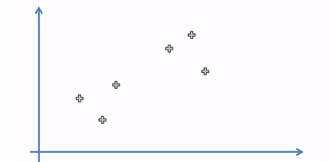
Hierarchical Clustering : Modeling – Distance between two clusters
overall_0_132335268282037724 columns_1_132225817802942803 2_1_132335268182249538
BIVARIATE Analysis
Step 1: Consider 6 points in the dataset

Slide 49
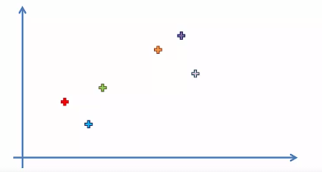
Hierarchical Clustering : Modeling – Distance between two clusters
overall_0_132335268282037724 columns_1_132225817802942803 2_1_132335268182249538
BIVARIATE Analysis
Step 2: Make each data point as single point cluster (N =6)

Slide 50
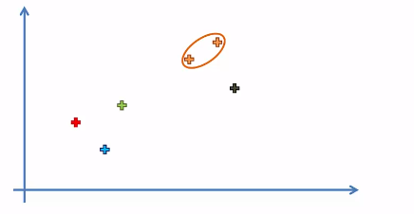
Hierarchical Clustering : Modeling – Distance between two clusters
overall_0_132335268282037724 columns_1_132225817802942803 2_1_132335268182249538
BIVARIATE Analysis
Step 3: Take two closest data point and make them as one cluster (N =5)

Slide 51
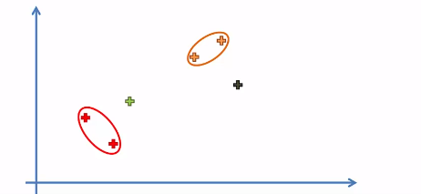
Hierarchical Clustering : Modeling – Distance between two clusters
overall_0_132335268282037724 columns_1_132225817802942803 2_1_132335268182249538
BIVARIATE Analysis
Step 4: Take two closest data point and make them as one cluster (N =4)

Slide 52
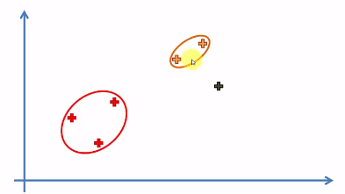
Hierarchical Clustering : Modeling – Distance between two clusters
overall_0_132335268282037724 columns_1_132225817802942803 2_1_132335268182249538
BIVARIATE Analysis
Step 5: Take two closest data point and make them as one cluster (N =3)

Slide 53
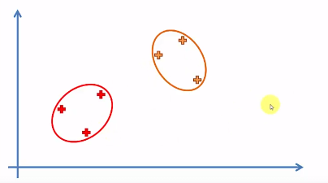
Hierarchical Clustering : Modeling – Distance between two clusters
overall_0_132335268282037724 columns_1_132225817802942803 2_1_132335268182249538
BIVARIATE Analysis
Step 6: Take two closest data point and make them as one cluster (N =2)

Slide 54
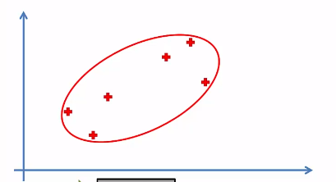
Hierarchical Clustering : Modeling – Distance between two clusters
overall_0_132335268282037724 columns_1_132225817802942803 2_1_132335268182249538
BIVARIATE Analysis
Step 7: Take two closest data point and make them as one cluster (N =1)

Slide 55
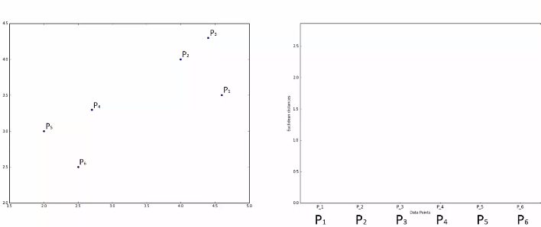
Hierarchical Clustering : Creation of Dendogram
overall_0_132335268282037724 columns_1_132225817802942803 2_1_132335268182249538
BIVARIATE Analysis
Dendogram is memory of Hierarchical clustering algorithm. It will remember each and every step

Slide 56
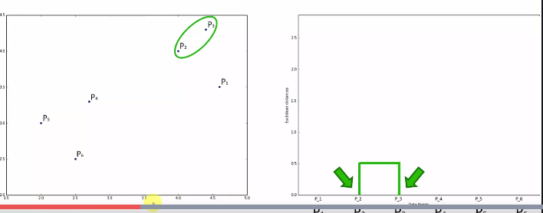
Hierarchical Clustering : Creation of Dendogram
overall_0_132335268282037724 columns_1_132225817802942803 2_1_132335268182249538
BIVARIATE Analysis
Height of the Dendogram represents distance between P2 and P3
Distance represent dissimilarity between two points. If points are dissimilar, distance is greater
Points
Dendogram

Slide 57
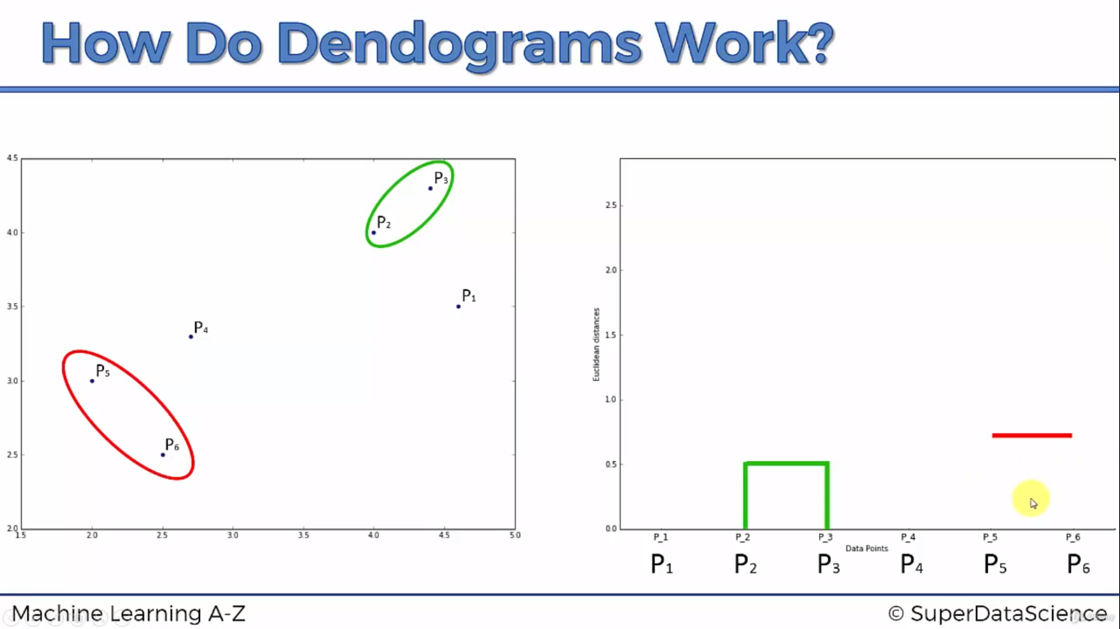
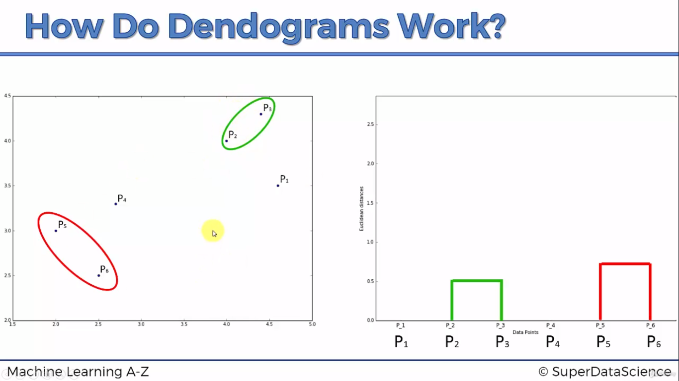
Hierarchical Clustering : Creation of Dendogram
overall_0_132335268282037724 columns_1_132225817802942803 2_1_132335268182249538
BIVARIATE Analysis
Now, we will identify the next two closest points (P5 and P6)
Points
Dendogram

Slide 58
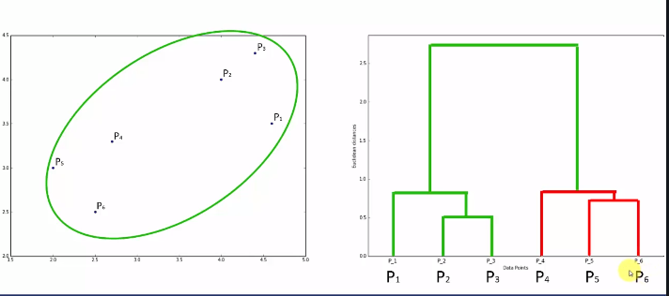
Hierarchical Clustering : Creation of Dendogram
overall_0_132335268282037724 columns_1_132225817802942803 2_1_132335268182249538
BIVARIATE Analysis
Dendogram is memory of Hierarchical clustering algorithm. It will remember each and every step
Points
Dendogram

Slide 59
Hierarchical Clustering : Creation of Dendogram – Two Clusters
overall_0_132335268282037724 columns_1_132225817802942803 2_1_132335268182249538
BIVARIATE Analysis
EXAMPLE 1
Y axis represents distance between different clusters
Set distance thresholds
If distance > = 1.5, it should be a different cluster
If distance<1.5, it should be one cluster
Thus, distance threshold = 1.5 divides into 2 clusters
Cluster 1
Cluster 2

Slide 60
Hierarchical Clustering : Creation of Dendogram – Two Clusters
overall_0_132335268282037724 columns_1_132225817802942803 2_1_132335268182249538
BIVARIATE Analysis
EXAMPLE 1
Result for Two clusters: All the points in any cluster are less than or equal to 1.5 units

Slide 61
Hierarchical Clustering : Creation of Dendogram – Four Clusters
overall_0_132335268282037724 columns_1_132225817802942803 2_1_132335268182249538
BIVARIATE Analysis
EXAMPLE 2
Y axis represents distance between different clusters
Set distance thresholds
If distance > = 0.8, it should be a different cluster
If distance<0.8, it should be one cluster
Thus, distance threshold = 0.8 divides into 4 clusters
Cluster 1
Cluster 2
Cluster 3
Cluster 4

Slide 62
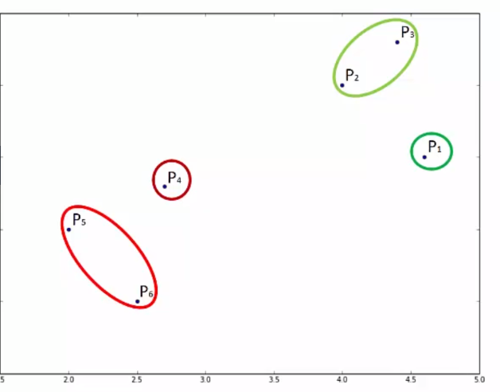
Hierarchical Clustering : Creation of Dendogram – Four Clusters
overall_0_132335268282037724 columns_1_132225817802942803 2_1_132335268182249538
BIVARIATE Analysis
EXAMPLE 2
Result for Four clusters: All the points in any cluster are less than or equal to 0.8 units

Slide 63

Hierarchical Clustering – Optimal Number of Clusters
overall_0_132335268282037724 columns_1_132225817802942803 2_1_132335268182249538
BIVARIATE Analysis
How to find
optimal number of clusters?

Slide 64
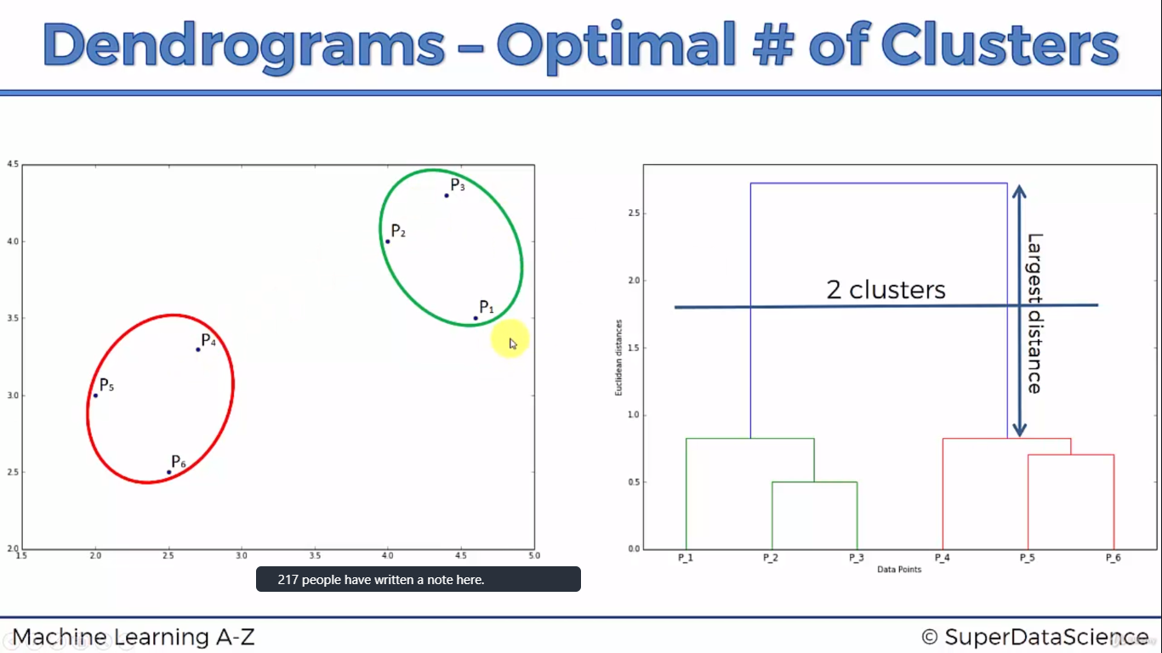
Hierarchical Clustering – Find optimal number of clusters
overall_0_132335268282037724 columns_1_132225817802942803 2_1_132335268182249538
BIVARIATE Analysis
Find the largest vertical line which is not intersected by any horizontal line

Slide 65
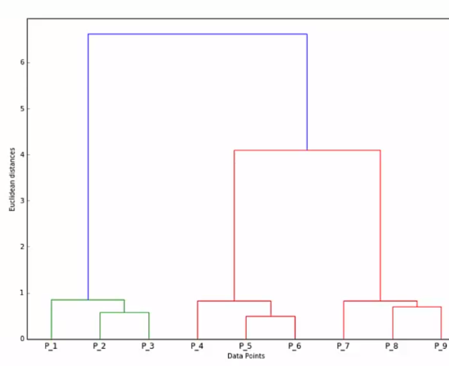
Hierarchical Clustering – Find optimal number of clusters
overall_0_132335268282037724 columns_1_132225817802942803 2_1_132335268182249538
BIVARIATE Analysis
Quiz: Find Optimal number of clusters in the below dendogram

Slide 66
Hierarchical Clustering – Find optimal number of clusters
overall_0_132335268282037724 columns_1_132225817802942803 2_1_132335268182249538
BIVARIATE Analysis
Quiz: Find Optimal number of clusters in the below dendogram
Solution: 3 Clusters
Cluster 1
Cluster 2
Cluster 3

Slide 67

7.1: Modeling using Hierarchical Clustering
overall_0_132335268282037724 columns_1_132225817802942803 2_1_132335268182249538
BIVARIATE Analysis
Ward method minimizes variances between the clusters
1) Develop Hierarchical Clustering Model
We will use scipy library, cluster module, hierarchy andsub-module
We need to import two functions – Dendogram function and Linkage Function
Linkage
Function
Dendogram Function
Linkage
matrix
Dataset
Create
Linkage matrix
(using ward method)
Convert
Linkage matrix
to Dendogram
Dendogram

Slide 68

7.1: Modeling using Hierarchical Clustering
overall_0_132335268282037724 columns_1_132225817802942803 2_1_132335268182249538
BIVARIATE Analysis
Ward method minimizes variances between the clusters
1) Find optimal number of clusters
from scipy import cluster.hierarchy as sch
dendrogram = sch.dendrogram(sch.linkage(dataset_std, method = 'ward'))
plt.title('Dendrogram')
plt.xlabel('Customers')
plt.ylabel('Euclidean distances')
plt.show()
Cluster 1
Cluster 2
Cluster 3
Cluster 4

Slide 69
7.1: Modeling using Hierarchical Clustering
overall_0_132335268282037724 columns_1_132225817802942803 2_1_132335268182249538
BIVARIATE Analysis
Train Model
from sklearn.cluster import AgglomerativeClustering
hc = AgglomerativeClustering(n_clusters = 4, affinity = 'euclidean', linkage = 'ward')
y_hc = hc.fit_predict(dataset_std)
Add Y variable to the original dataset
y=pd.DataFrame({'Cluster Name': y_hc})
dataset['Cluster Name']= y['Cluster Name']

Slide 70

7.1: Modeling using Hierarchical Clustering
overall_0_132335268282037724 columns_1_132225817802942803 2_1_132335268182249538
BIVARIATE Analysis
Analysis of Clusters
dataset.groupby(by ='Cluster Name').mean()
Fewer opportunity
Career Focused
Well Settled
Average
Career Focused: Single men focusing on only careers earning 2nd highest salary
Average High school passed people employed in skilled job (living in small and medium cities)
Fewer opportunity: High school passed people employed mostly in low skilled jobs (living in small cities)
Well Settled: Married elder people with University+ education and High Income

Slide 71


K-Means Clustering Intuition
overall_0_132335268282037724 columns_1_132225817802942803 2_1_132335268182249538
BIVARIATE Analysis

Slide 72
K-Means Clustering Intuition
overall_0_132335268282037724 columns_1_132225817802942803 2_1_132335268182249538
BIVARIATE Analysis
Steps in K means Clustering Algorithm
Choose the number of clusters (say K)
Select at random K points as centroids (not necessarily from your dataset)
Assign each data point to the closest centroid
Compute new centroid for each cluster
Reassign each data point to the new closest centroid

Slide 73

K-Means Clustering Intuition
overall_0_132335268282037724 columns_1_132225817802942803 2_1_132335268182249538
BIVARIATE Analysis
Steps in K means Clustering Algorithm
Choose the number of clusters (say K)
Say K =2 (will discuss later)

Slide 74

K-Means Clustering Intuition
overall_0_132335268282037724 columns_1_132225817802942803 2_1_132335268182249538
BIVARIATE Analysis
Steps in K means Clustering Algorithm
2. Select at random 2 points as centroids (not necessarily from your dataset)

Slide 75

K-Means Clustering Intuition
overall_0_132335268282037724 columns_1_132225817802942803 2_1_132335268182249538
BIVARIATE Analysis
Steps in K means Clustering Algorithm
3. Assign each data point to the closest centroid
Any point on green line is equidistant to the red/blue centroid

Slide 76

K-Means Clustering Intuition
overall_0_132335268282037724 columns_1_132225817802942803 2_1_132335268182249538
BIVARIATE Analysis
Steps in K means Clustering Algorithm
3. Assign each data point to the closest centroid

Slide 77

K-Means Clustering Intuition
overall_0_132335268282037724 columns_1_132225817802942803 2_1_132335268182249538
BIVARIATE Analysis
Steps in K means Clustering Algorithm
4. Compute new centroid for each cluster

Slide 78

K-Means Clustering Intuition
overall_0_132335268282037724 columns_1_132225817802942803 2_1_132335268182249538
BIVARIATE Analysis
Steps in K means Clustering Algorithm
These points will be re-assigned
5. Reassign data points to centroid (BEFORE RE-ASSIGNMENT)

Slide 79

K-Means Clustering Intuition
overall_0_132335268282037724 columns_1_132225817802942803 2_1_132335268182249538
BIVARIATE Analysis
Steps in K means Clustering Algorithm
5. Reassign data points to centroid (AFTER RE-ASSIGNMENT)

Slide 80

K-Means Clustering Intuition
overall_0_132335268282037724 columns_1_132225817802942803 2_1_132335268182249538
BIVARIATE Analysis
Steps in K means Clustering Algorithm
6. Final Model (No iteration take place now)

Slide 81

K-Means Clustering Intuition
overall_0_132335268282037724 columns_1_132225817802942803 2_1_132335268182249538
BIVARIATE Analysis
Steps in K means Clustering Algorithm
6. Final Model (No iteration take place now)

Slide 82


K-Means Clustering Intuition – Select Number of Clusters
overall_0_132335268282037724 columns_1_132225817802942803 2_1_132335268182249538
BIVARIATE Analysis
Within Cluster Sum of Square (WCSS)

Slide 83

K-Means Clustering Intuition – Select Number of Clusters
overall_0_132335268282037724 columns_1_132225817802942803 2_1_132335268182249538
BIVARIATE Analysis
Within Cluster Sum of Square (WCSS)
K =1

Slide 84


K-Means Clustering Intuition – Select Number of Clusters
overall_0_132335268282037724 columns_1_132225817802942803 2_1_132335268182249538
BIVARIATE Analysis
Within Cluster Sum of Square (WCSS)
K =2

Slide 85


K-Means Clustering Intuition – Select Number of Clusters
overall_0_132335268282037724 columns_1_132225817802942803 2_1_132335268182249538
BIVARIATE Analysis
Within Cluster Sum of Square (WCSS)
K =3

Slide 86

K-Means Clustering Intuition – Select Number of Clusters
overall_0_132335268282037724 columns_1_132225817802942803 2_1_132335268182249538
BIVARIATE Analysis
Within Cluster Sum of Square (WCSS)
You can increase the clusters and WCSS will go down
When number of clusters = number of points then WCSS will be 0
Elbow Method

Slide 87

7.2: Modeling using K-Means Clustering
overall_0_132335268282037724 columns_1_132225817802942803 2_1_132335268182249538
BIVARIATE Analysis
1) Find optimal number of clusters
from sklearn.cluster import KMeans
wcss = []
for i in range(1, 11):
kmeans = KMeans(n_clusters = i, init = 'k-means++', random_state = 42)
kmeans.fit(dataset_std)
wcss.append(kmeans.inertia_)
plt.plot(range(1, 11), wcss)
plt.title('The Elbow Method')
plt.xlabel('Number of clusters')
plt.ylabel('WCSS')
plt.show()

Slide 88
7.2: Modeling using K-Means Clustering
overall_0_132335268282037724 columns_1_132225817802942803 2_1_132335268182249538
BIVARIATE Analysis
Train Model
kmeans = KMeans(n_clusters = 4, init = 'k-means++', random_state = 42)
y_kmeans = kmeans.fit_predict(dataset_std)
Add Y variable to the original dataset
dataset['Cluster Name']= y_kmeans

Slide 89

7.2: Modeling using K-Means Clustering
overall_0_132335268282037724 columns_1_132225817802942803 2_1_132335268182249538
BIVARIATE Analysis
Analysis of Clusters
dataset.groupby(by ='Cluster Name').mean()
Well Settled
Fewer opportunity:
Career Focused:
Average
Career Focused: Single men focusing on only careers earning 2nd highest salary
Average High school passed people employed in skilled job (living in small and medium cities)
Fewer opportunity: High school passed people employed mostly in low skilled jobs (living in small cities)
Well Settled: Married elder people with University+ education and High Income

